Slide 1
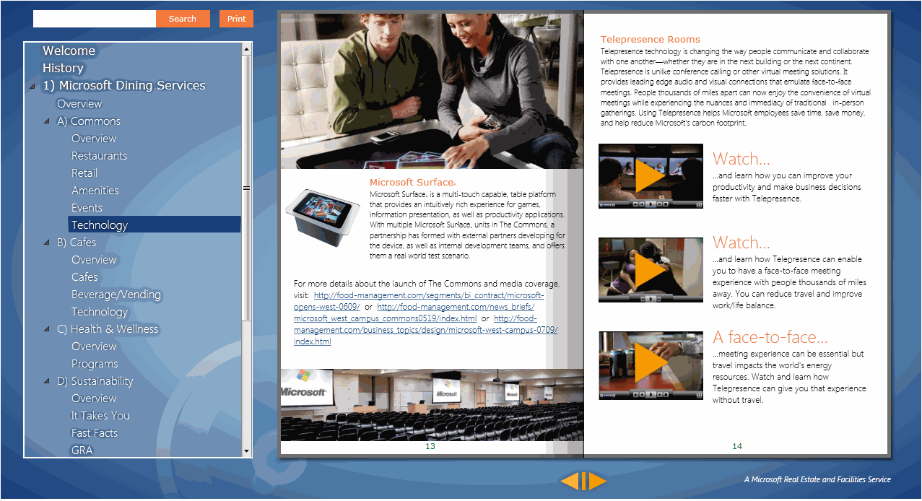
Flipbook Graphic Design
The Challenge
Affirma was engaged by Microsoft to create a virtual guide to the world of Microsoft Dining Services and Microsoft Meeting Solutions. The Flip Book needed a design that would convey the innovative and intelligent hospitality solutions provided by Microsoft.
What We Did
Affirma successfully created an interactive Tourbook that portrays Microsoft Dining Services and Microsoft Meeting Solutions as leaders and innovators in the dining and meeting industry space.
Results
Microsoft is currently using the Flip Book as a comprehensive guide to showcase their cutting-edge solutions that savvy Microsoft customers expect.

